Slide 1
Rules: 2-4 Teams Scribe: to record answers for each round Responses: letters must be legible Points: Each question correct (written on fancy sheet) gets 1 pt. Teams that answer correctly go to Bonus Round Quickest team correct (via sheets up) in Bonus Round gets the rock to shoot for Bonus pts 3 shots allowed at 1 pt each
Barratt b-ball trivia
UNIT 4: 1800-1848

Slide 2
Thomas Jefferson’s reduction of the navy left the United States trade ships vulnerable from this threat plaguing Mediterranean trade routes.
Round one
A: Barbary Pirates

Slide 3
The Judiciary Act of 1801 allowed Adams to pack the Supreme Court with these last minute appointees.
Bonus Round one
A: Midnight Judges

Slide 4
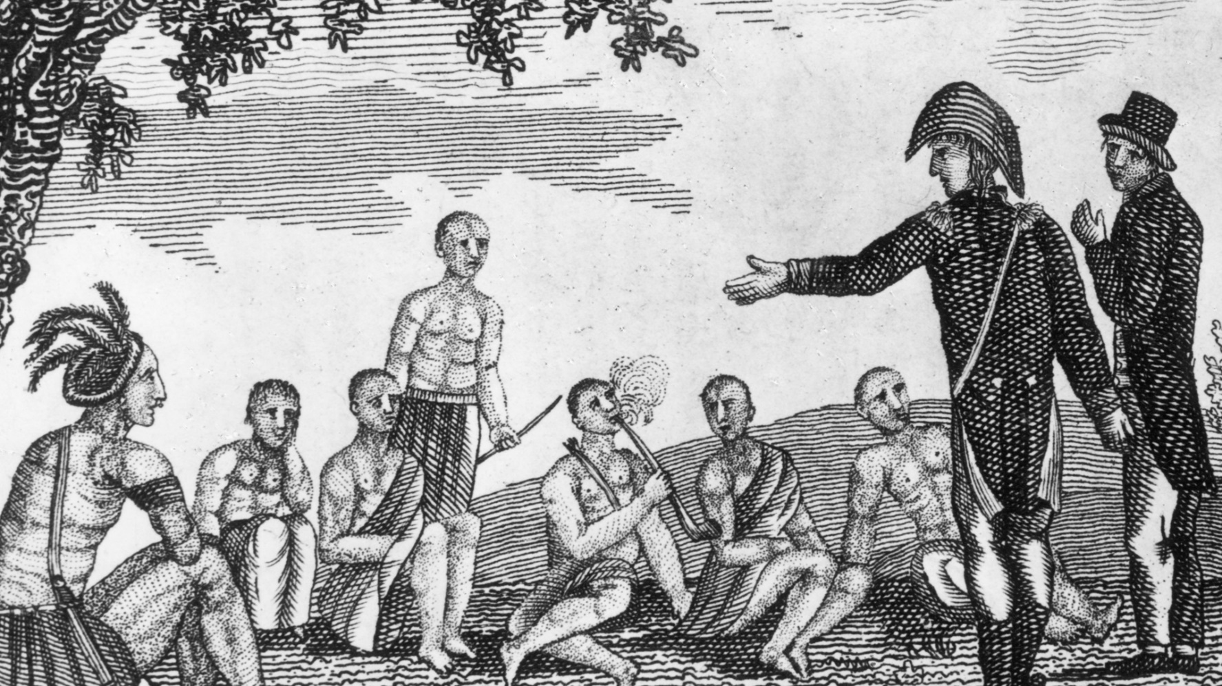
Round two
This image takes account of the Corps of Discovery Expedition from 1804-1806 led by:
A: Lewis & Clark

Slide 5
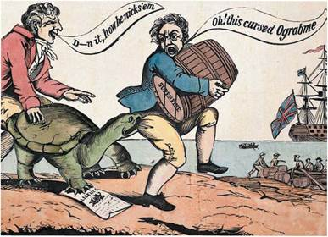
Bonus Round two
Based on the cartoon, identify Jefferson’s policy that was largely deemed a failure.
A: Embargo Act of 1807

Slide 6
Identify the nickname of these young Congressmen, the majority of whom were Democrat-Republicans, who advocated for a second war against Britain in 1812. James Madison acquiesced to their demands.
Round three
A: “War Hawks”

Slide 7
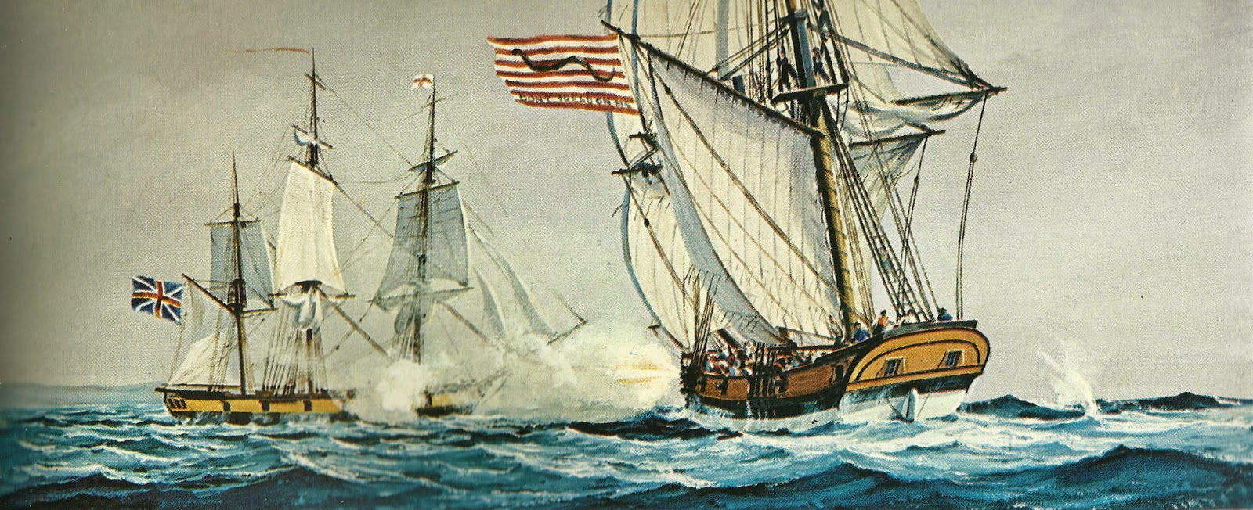
The very weak and limited United States navy relied on commissions granted to these individual vessels to raid and harass British merchant vessels and warships.
Bonus Round three
A: Privateers

Slide 8
“The power to tax is the power to destroy…” remarked John Marshall in this influential Supreme Court case which protected the Bank of the United States from sectional interests.
Round four
A: McCulloch v. Maryland

Slide 9
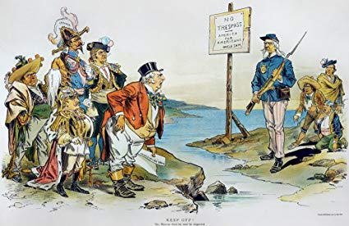
Bonus Round four
The cartoon suggests a foreign policy originally laid out in what famous 1823 declaration?
A: Monroe Doctrine

Slide 10
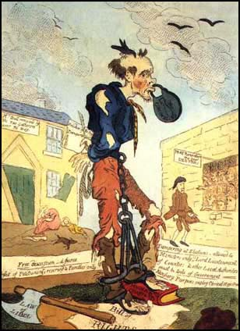
This economic downturn, shown critically in the cartoon, was caused by bank failures, decline in crop prices, and foreign competition.
Round five
A: Panic of 1819

Slide 11
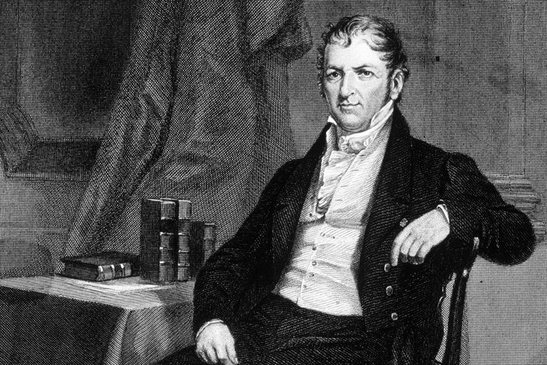
Bonus Round five
Hi there! My invention of the cotton gin and innovations of interchangeable parts revolutionized American agriculture and industry!
Who am I?
A: Eli Whitney

Slide 12
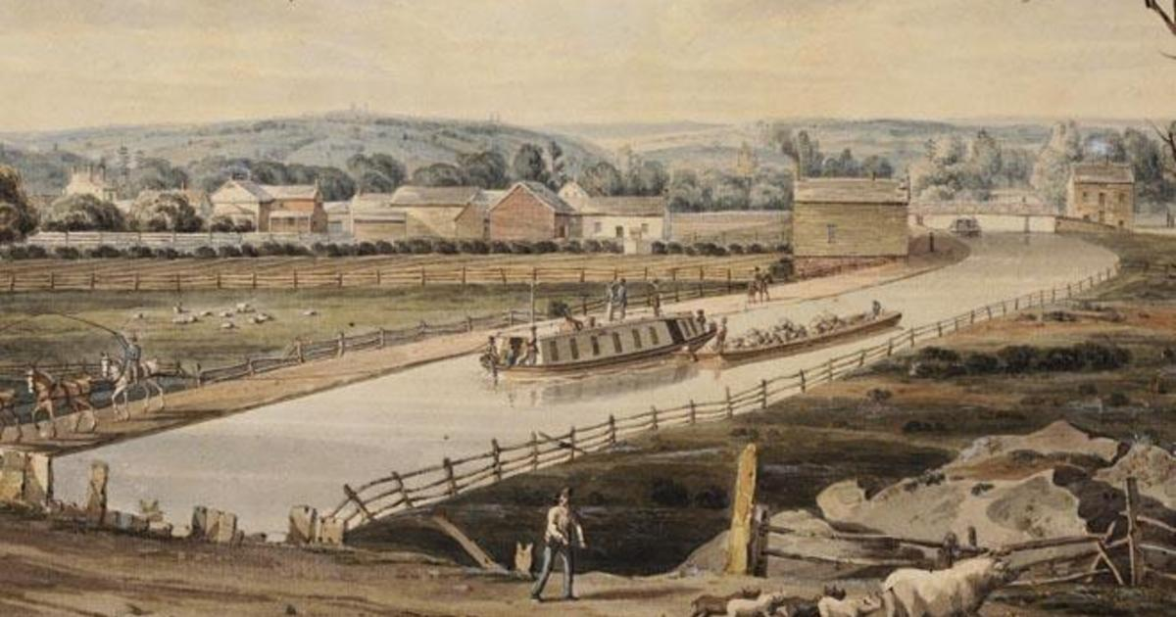
This shining example of American ingenuity and a key component of the American System helped westward expansion and trade. (Be specific!)
Round six
A: Erie Canal

Slide 13
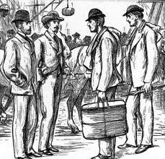
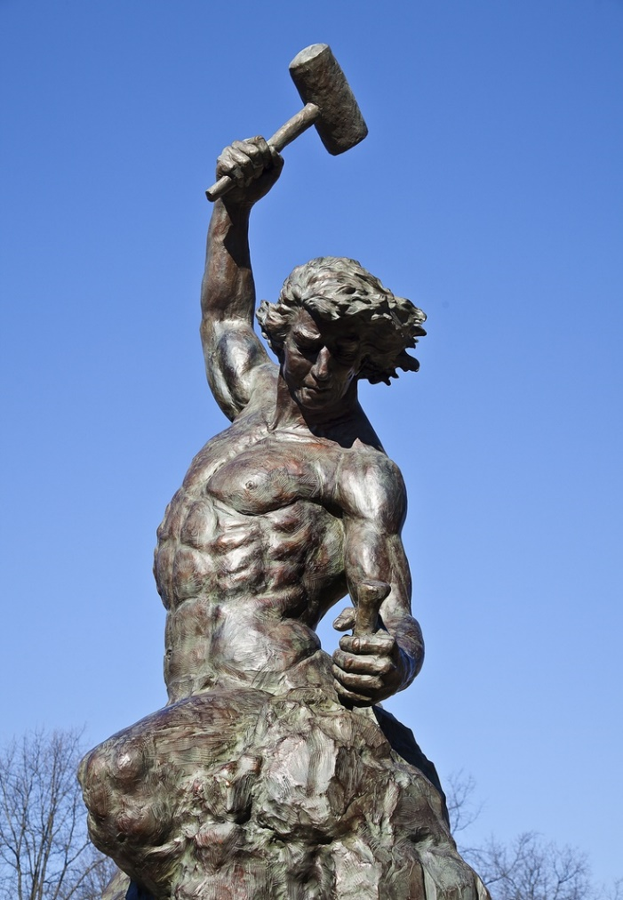
Bonus Round six
The American middle class began to espouse great pride in this concept. It signified a rejection of elitism and entrenched aristocracy.
A: “Self Made Man”

Slide 14
Andrew Jackson and Martin van Buren were early proponents of providing jobs to loyal campaign supporters, known as:
Round seven
A: Spoils System

Slide 15
The above quote references what political incident?
Bonus Round seven
"The Judas of the West has closed the contract and will receive the thirty pieces of silver. [...] Was there ever witnessed such a bare faced corruption in any country before?“ --- Andrew Jackson on Henry Clay, 1824
A: ”The Corrupt Bargain”

Slide 16
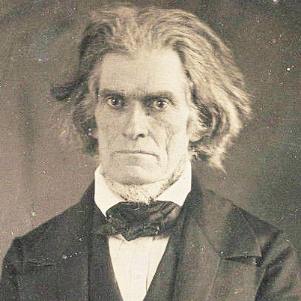
Round eight
If you got me wrong …. I’m coming after YOUUUUUU!!!!!
Identify the individual with this career record:
War Hawk who voted ‘Yea’ on War of 1812
Vice President of Andrew Jackson
Coined the phrase the “Tariff of Abominations”
Wrote the “South Carolina Exposition”
Lifelong advocate for slavery
A: John C. Calhoun

Slide 17
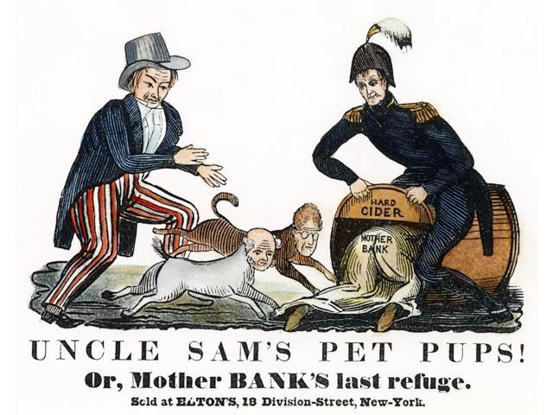
Bonus Round eight
Identify the individual and the economic plan he is associated with criticized in the cartoon.
A: Andrew Jackson, “Pet Banks”

Slide 18
Round nine
Identify one of two popular slogans embraced by the Whig Party in 1840 designed to generate voter interest amongst the “common man”. *Identify both for two points.
A: “Tippecanoe & Tyler Too”
or
“Log Cabins & Hard Cider”

Slide 19
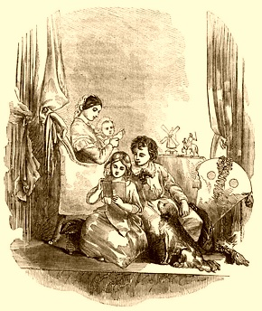
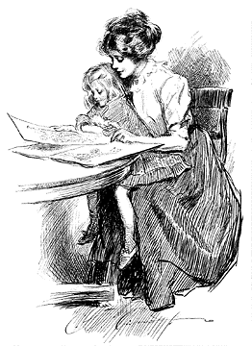
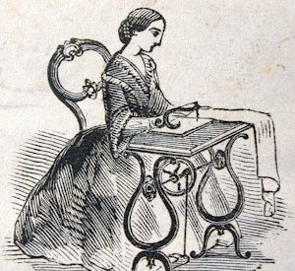
Bonus Round nine
Identify the movement that expressed pride in the stability provided in the familial roles of women.
A: “Cult of Domesticity”

Slide 20
Round ten
“To be yourself in a world that is constantly trying to make you something else is the greatest accomplishment.”
The above quote reflects what philosophical movement during the early 19th century?
A: Transcendentalism

Slide 21
Bonus Round ten
Revivalism, the Shaker movement, Utopianism, Mormonism, the African Methodist Episcopal Church, and dozens of other religious denominations were all part of what major American movement of the 1830’s?
A: 2nd Great Awakening

Slide 22
Rules: Option 1 (Sabotage) – Agent gets 3 shots, each score removes 1 pt from resident team Option 2 (Gamble) – Team may risk their own pts for up to 3 shots, each risked shot loses 1 pt, but has potential to be worth 3 pts if scored Each team can exercise one of the above options in this round.
Money shot round

Slide 23
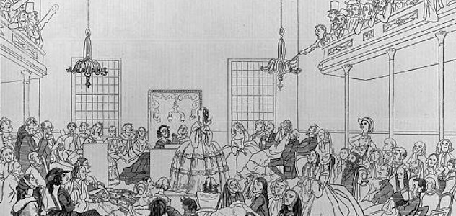
Round eleven
This event in 1848 was a paramount moment in the history of women’s rights.
A: Seneca Falls Convention

Slide 24
Bonus Round eleven
Identify the modern day African nation that began as the site for a “Back to Africa” relocation effort by early abolitionists.
A: Liberia

Slide 25
Round twelve
Of the following, which was never affiliated with Democratic or Republican party (in any of its variations)?
John Adams
Thomas Jefferson
Andrew Jackson
Martin van Buren
A: John Adams

Slide 26
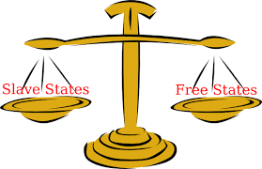
Bonus Round twelve
This domestic agreement was established in 1820 to address the main idea of the image.
A: Missouri Compromise

Slide 27
“You have asked me to give a history of the motives which induced me to undertake the late insurrection, as you call it…To do so I must go back to the days of my infancy, and even before I was born.”
Round thirteen
Identify the individual responsible for this quote and the failed “insurrection” he is on trial for.
A: Nat Turner

Slide 28
Bonus Round thirteen
Southern Congressmen devised this policy to stop any discussion of abolition of slavery on the floors of Congress.
A: The Gag Rule

Slide 29
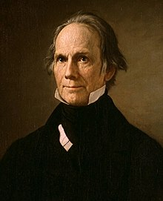
Round fourteen
Did ya get me right?
Holla!
This “Great Compromiser” unsuccessfully ran for President four times, but retains credit for such accomplishments as the American System, Missouri Compromise, the Compromise Tariff, and initiating the Compromise of 1850.
A: Henry Clay

Slide 30
Bonus Round fourteen
These Shawnee brothers met defeat at the hands of American militia in the Battle of Tippecanoe. This prompted them to
ally with the British during the War of 1812.
A: Tecumseh & the Prophet

Slide 31
Round fifteen
Deemed by historians as the greatest Secretary of State the nation has ever had, helping to expand borders and establish diplomatic ties with Europe. Yet he was largely unsuccessful as a president.
A: John Quincy Adams

Slide 32
Bonus Round fifteen
This action that embodies the concept of states’ rights was promoted in the arguments presented in the Virginia & Kentucky Resolutions and Calhoun’s South Carolina Exposition.
A: Nullification

Slide 33
Be sure to organize your materials to best study and prepare for the Unit 4 Test.
Thanks for playing!

